Slide 1
VEMCO VR2C Acoustic Transceiver Multiplexer

Slide 2
CSULB Sharklab
"Our mission is to advance our understanding of the ecology of marine fishes, training future marine scientists at the undergraduate and graduate levels, and disseminate information to resource managers and the general public to improve conservation of marine fishes."
-- Sharklab Mission Statement

Slide 3

VEMCO Acoustic Transceiver

Slide 4

Community Outreach
Middle school purchased VR2C acoustic transceiver to learn about shark behavior.
CSULB Sharklab will place transceiver at Manhattan Beach Pier.

Slide 5
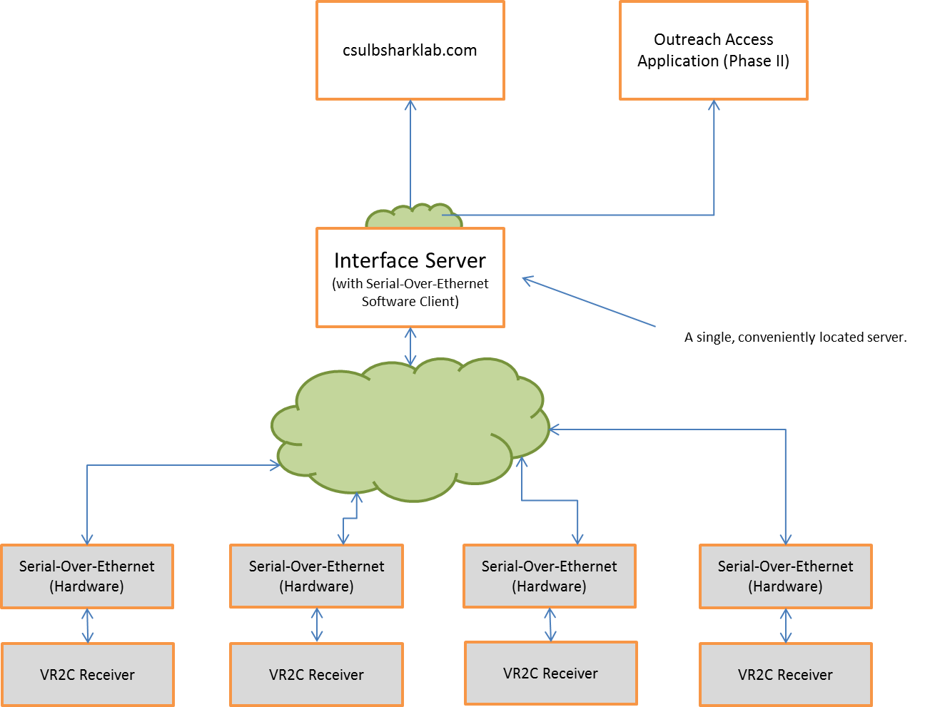
We Make the Connection

Slide 6
Division of Labor
"Back-End"
Receives data from and control VEMCO transceivers.
Parse/Decodes messages
Re-Encode as SQL and send to MySQL database
"Front-End"
Extends existing csulbsharklab.com site.
Provides easy access "Real-Time" data
Send email alerts

Slide 7
Technology Used
"Back-End"
Text (over RS-232)
JSON
XAML
C# and WPF
SQL
Regular Expressions
XMLdocs and Sandcastle
Serial-Over-Ethernet Bridge
"Front-End"
PHP
JavaScript (jQuery)
Java
LAMP/WAMP
SQL

Slide 8
"Back End" Overview
Server UI
Serial Port Servicer
Receiver (VEMCO Transceiver Class)
Event Dispatcher
UI Module
Decoder Module
Database Module
WatchDog Module

Slide 9
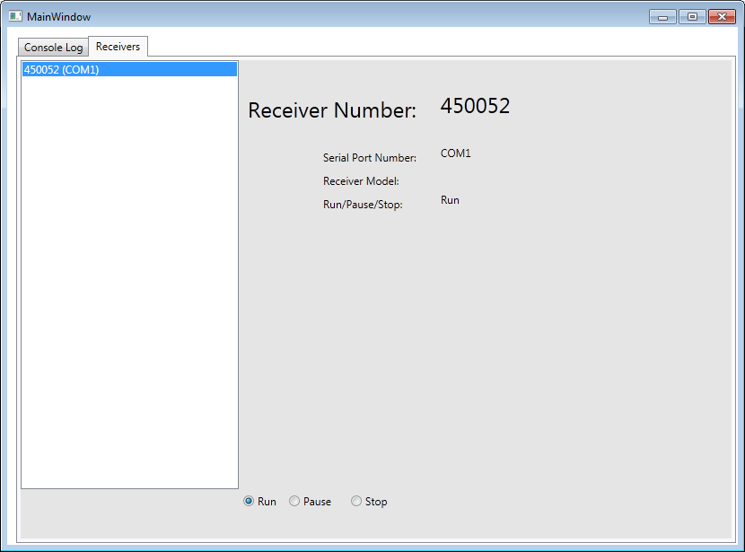
Server UI - Receiver Contol

Slide 10
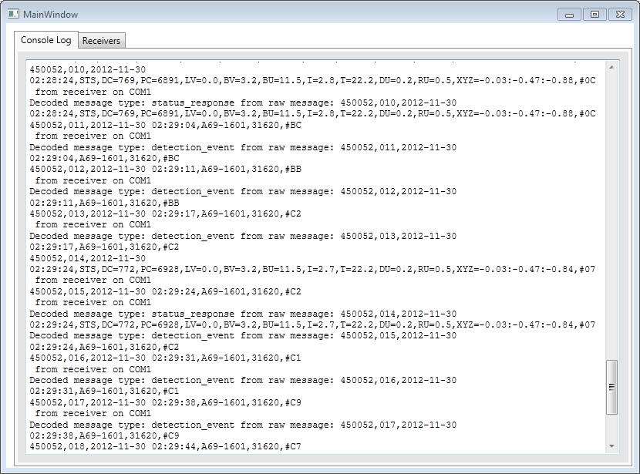
Console Output

Slide 11
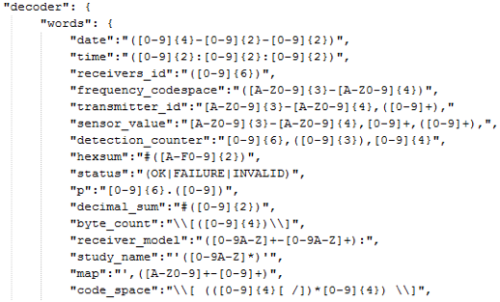
Decoder Module
Determines type of message sent by receiver.
Decodes messages using configurable RegEx.
450052,007,2012-10-02 21:49:36,A69-9001,30444,#CC

Slide 12
Database Module
Takes decoded messages from Decoder.
Makes insertions into the database.
Physical receiver → Unparsed message → Decoder → Decoded message → Database insertion

Slide 13
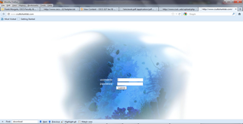
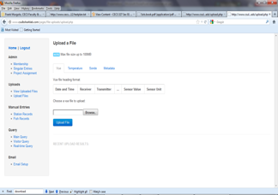
Front-End: http://www.csulbsharklab.com
Previously done as a senior project.
Central repository for marine biology department data.
Requires manual upload of CSV data.

Slide 14
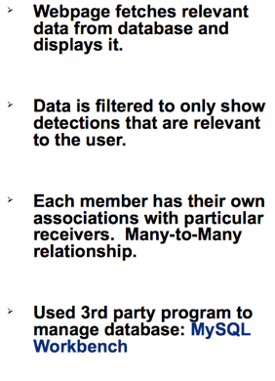
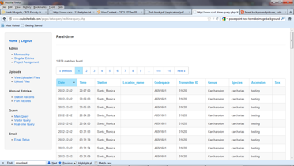
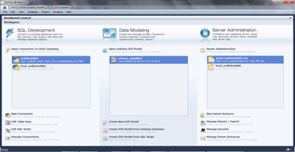
Real-Time Display

Slide 15
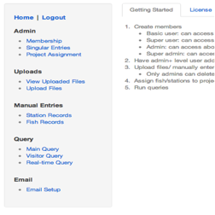
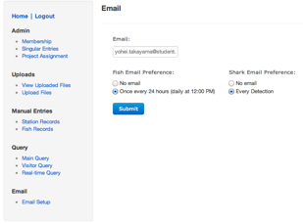
Email-Alert Setting
Log into http://www.csulbsharklab.com
Click "Email Setup"
Enter your email address
Choose "Email Preferences"
Click Submit

Slide 16
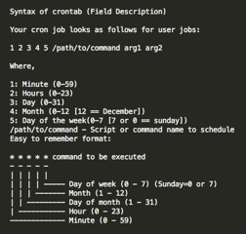


CRON
Time-based job scheduler
Enables users to schedule jobs (command or shell scripts to run periodically at certain times or dates.
Company providing hosting services for csulbsharklab.com provides "cpanel" which allows CRON jobs to set up.
You can set cron job in your Mac or Linux computer through terminal as well.

